Slide 1
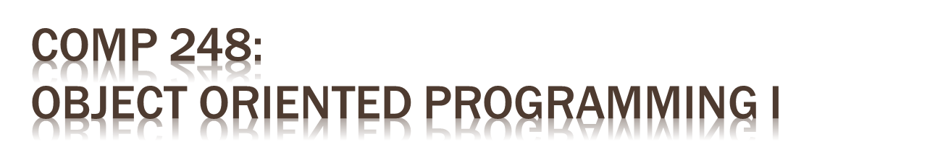
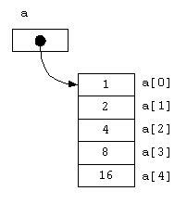
Chapter 6 - Part A:
Arrays of Primitive Data Types

Slide 2

Arrays
Sorting
Multidimensional arrays

Slide 3
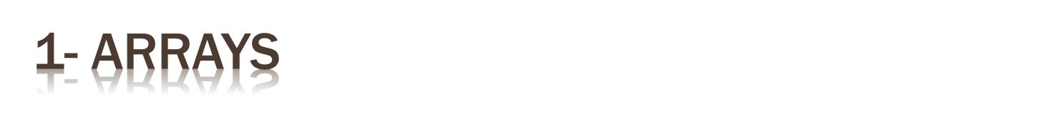
Problem:
  read 200 marks and compute how many are < the average…
  need to store 200 variables !!!
Solution:
  use an array!
  an array is an object that help us organize large amounts of information
Please enter mark nb 1: 80
Please enter mark nb 2: 65.5
…
Please enter mark nb 200: 68
The average is: 65.3
117 students have a mark higher than the average
Output

Slide 4

An array is an ordered list of elements of the same type
An array of size n is indexed from 0 to n-1
The entire array
has a single name
Each value has a numeric index
0 1 2 3 4 5 6 7 8 9
scores
79 87 94 82 67 98 87 81 74 91
This array holds 10 values that are indexed from 0 to 9

Slide 5
The elements of an array can be:
  a primitive type or
  an object reference (we'll see this later)

Slide 6


declaring the reference:
  syntax: type_of_elements[] name_of_array;
creating the elements:
  syntax: name_of_array = new type_of_elements[size];
declaration + creation
int[] scores; double[] marks;
char[] vowels; String[] sentence;
scores = new int[10];
.
int [] scores = new int[10];

Slide 7
size of the array:
  must be an integer expression (constant or variable)
array initialization
  every element is initialized to zero
    int, double --> 0
    boolean --> false
    references --> null
double[] price;
int nbItems = Keyboard.readInt();
price = new double[nbItems];

Slide 8

we can declare and initialize an array in one step
Note:
  no size value is specified (size = nb of elements specified)
  the new operator is not used
int[] units = {147, 323, 89, 933, 540, 269, 298, 476};
char[] letterGrades = {'A', 'B', 'C', 'D', ’F'};

Slide 9


Which of the following initializer lists correctly initializes the indexed variables of an array named myDoubles?
  double myDoubles[double] = {0.0, 1.0, 1.5, 2.0, 2.5};
  double myDoubles[5] = new double(0.0, 1.0, 1.5, 2.0, 2.5);
  double[] myDoubles = {0.0, 1.0, 1.5, 2.0, 2.5};
  array myDoubles[double] = {0.0, 1.0, 1.5, 2.0, 2.5};
  All of the above are valid

Slide 10
Given the declaration
int[] alpha = new int[75];
the valid range of index values for alpha is:
0 through 75
0 through 74
1 through 75
1 through 74
1 through 76

Slide 11

syntax: nameOfArray[indexOfElement]
assignment to elements… one by one
  double[] scores = new double[10];
  scores[2] = 55.5;
  scores[0] = scores[2] + 2;
double mean = (scores[0] + scores[2])/2;
  System.out.print(mean);
???
Output
fill an array with:
10 20 30 40 50
then display array
final int LIMIT = 5;
int[] list = new int[LIMIT];
???
To do

Slide 12

the index must be [0 … length-1]
The Java interpreter checks for you…
if an array index is out of bounds --> ArrayIndexOutOfBoundsException
  double [] codes = new double[100];
  int count = 100;
  System.out.println(codes[count]);
for (int index=0; index <= 100; index++)
codes[index] = index*50 + epsilon;

Slide 13

myArray[0] | 7
myArray[1] | 9
myArray[2] | -3
myArray[3] | 6
myArray[4] | 1
myArray[5] | -1
  Consider the following array:
What is the value of
myArray[myArray[1] – myArray[0]]
    2
    9
    -3
    6
    7

Slide 14
Given the declarations
int[] status = new int[10];
int i;
which of the following loops correctly fills the array status with 1s?
A) for (i = 0; i <= 10; i++)
status[i] = 1;
B) for (i = 0; i < 10; i++)
status[i] = 1;
C) for (i = 1; i <= 10; i++)
status[i] = 1;
D) for (i = 1; i < 10; i++)
status[i] = 1;
E) for (i = 1; i <= 11; i++)
status[i] = 1;

Slide 15

an array is an object
length is a public constant (an attribute) that gives the nb of elements in the array
int[] score = new int [10];
System.out.print(scores.length);
double[] numbers = new double[10];
System.out.println ("The size of the array: "+ numbers.length);
// to fill the array with user input
// to display in reverse order

Slide 16

How many students? 10
Please enter mark nb 1: 80
Please enter mark nb 2: 65.5
…
Please enter mark nb 10: 68
The average is: 65.3
4 students have a mark higher than the average
Output
Variables needed?
Algorithm?

Slide 17


Slide 18

Enter the age of the 30 children (from 0 to 10):
2 3 0 1 … 9
3 children are 0 years old
2 children are 1 years old
…
4 children are 10 years old
Variables needed?
Algorithm?

Slide 20
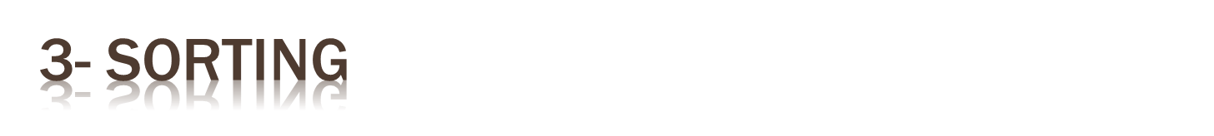
Sorting is the process of arranging a list of items in a particular order
There are many algorithms for sorting a list of items
  some are more efficient, some are more intuitive
    Selection Sort
    Insertion Sort
    Bubble Sort
    Quicksort
    …

Slide 21

The approach:
  select a value and put it in its final place into the list
  repeat for all other values
In more detail:
  find the smallest value in the array
  switch it with the value in the first position
  find the next smallest value in the array
  switch it with the value in the second position
  repeat until all values are in their proper places

Slide 22

original: 3 9 6 1 2
smallest is 1: 3 9 6 1 2
smallest is 2: 1 9 6 3 2
smallest is 3: 1 2 6 3 9
smallest is 6: 1 2 3 6 9
sorted array: 1 2 3 6 9

Slide 23
public static void selectionSort (int[] numbers)
{
int min, temp;
// for every element (except the last)
for (int index = 0; index < numbers.length-1; index++)
{
min = index;
// Find the smallest element between index and the last
for (int scan = index+1; scan < numbers.length; scan++)
if (numbers[scan] < numbers[min])
min = scan;
// Swap it with the index
temp = numbers[min];
numbers[min] = numbers[index];
numbers[index] = temp;
}
}

Slide 24
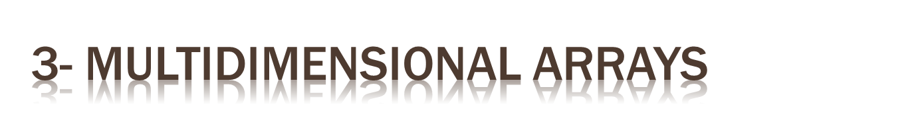
A one-dimensional array
  stores a list of elements of simple type (primitive or reference)
A two-dimensional array
  stores a list of elements, where each element is a 1-D array of simple type

Slide 25

a 2-D array is really a 1-D array of references to 1-D arrays
so the arrays within one dimension can be of different lengths (called ragged arrays)
not :
but:

Slide 26

Declaration:
Access to an element
double[] student = new double[5]; // 1-D 5 tests for 1 student
double[][] section = new double[5][80]; // 2-D 80 students per section
double[][][] course = new double[3][5][80]; // 3-D 5 sections per course
value = section[3][5]

Slide 27

Expression | Type | Description
section | int[][] | 2D array of integers, or 1D array of integer arrays
section[4] | int[] | 1D array of integers
section[4][12] | int | 1 integer

Slide 28

Given the declaration
double costOfGoods[ ][ ][ ]= new double [8][2][7];
how many float components does costOfGoods have?
8
70
72
112
17

Slide 29
Given the declarations
double x[] = new double[300];
double y[][] = new double[75][4];
double z[] = new double[79];
which of the following statements is true?
A) x has more components than y.
B) y has more components than x.
C) y and z have the same number of components.
D) x and y have the same number of components.
E) a and c above

Slide 30

  char[][] page = new char[30][100];
length does not give the total number of indexed variables
  page.length is equal to 30
  page[0].length is equal to 100
int row, col;
for (row = 0; row < page.length; row++)
for (col = 0; col < page[row].length; col++)
page[row][col] = 'Z';

Slide 31

int[][] table = new int[5][10];
for (int row=0; row < table.length; row++)
for (int col=0; col < table[row].length; col++)
table[row][col] = row * 10 + col;
for (int row=0; row < table.length; row++) {
for (int col=0; col < table[row].length; col++)
System.out.print (table[row][col] + "\t");
System.out.println();
}
Output

Slide 32

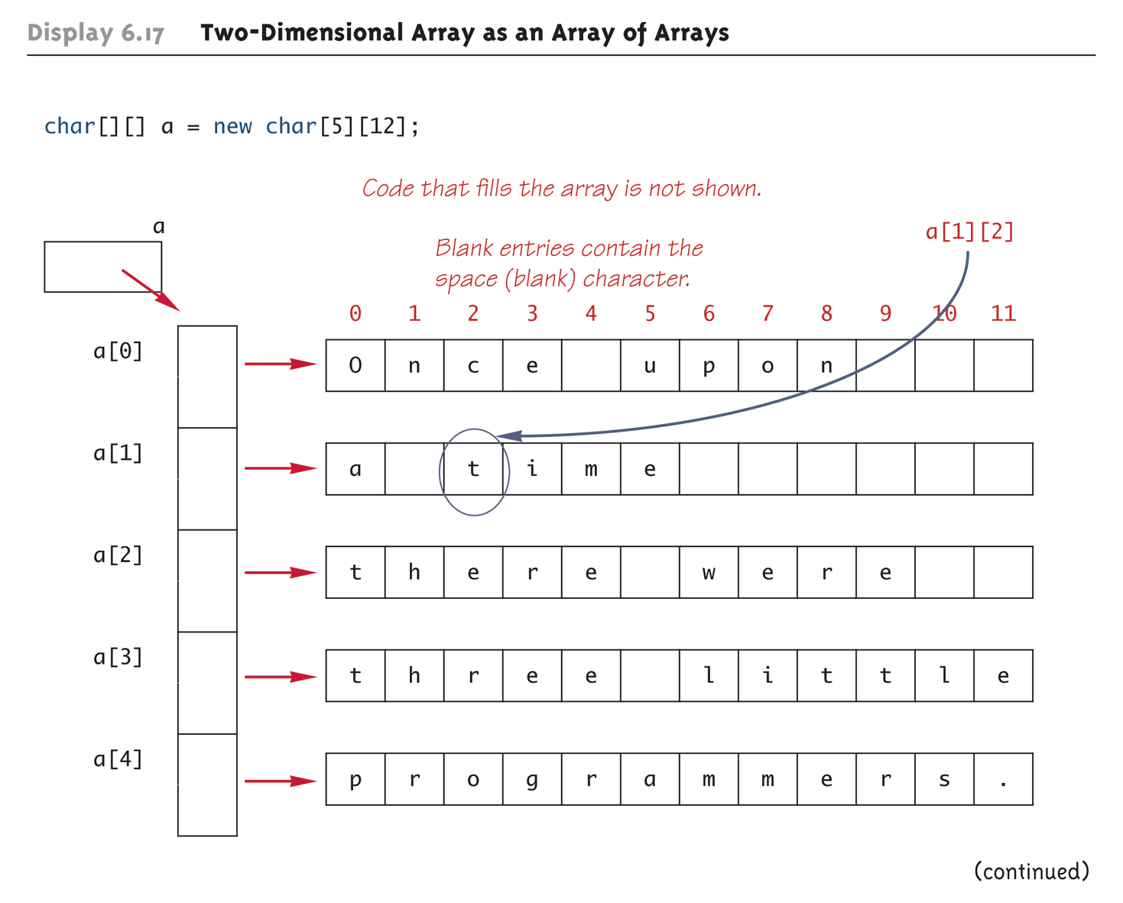

Slide 33

  double[][] a = new double[3][5];
is equivalent to:
  double [][] a;
  a = new double[3][];
  a[0] = new double[5];
  a[1] = new double[5];
  a[2] = new double[5];
So we could have:
  double [][] a = new double[3][];
  a[0] = new double[5];
  a[1] = new double[10];
  a[2] = new double[4];

Slide 34
int[][] scores = { {1, 2, 3}, {1, 1, 1}, {3, 4, 5},
{10, 20, 30} };
final int SODAS = scores.length;
final int PEOPLE = scores[0].length;
int[] sodaSum = new int[SODAS];
int[] personSum = new int[PEOPLE];
…………
Scores
sodaSum
personSum

Slide 35

……
for (int soda=0; soda < SODAS; soda++)
for (int person=0; person < PEOPLE; person++) {
sodaSum[soda] += scores[soda][person];
personSum[person] += scores[soda][person];
}
……
Scores
sodaSum
personSum

Slide 36
……
for (int soda=0; soda < SODAS; soda++)
System.out.println("Soda #" + (soda+1) + ": " + sodaSum[soda]/PEOPLE);
for (int person =0; person < PEOPLE; person++)
System.out.println ("Person #"+ (person+1) +": "+ personSum[person]/SODAS);
Output

